Slide 1

Java Backend System
Extensible
Workflow Engine
Marlone Nyapwere
Group #3
Java Implementation
UML-Based Design
Plugin Architecture

Slide 2
02 / Project Foundation
Project Overview
Project Description
Technology Stack
This project develops an extensible backend workflow engine that models and executes business processes using object-oriented analysis and design techniques. A workflow is represented as a sequence of steps connected by conditional transitions, enabling dynamic execution paths based on runtime data.
Java
Primary Language
UML 2.5
Modeling Standard
The system separates workflow definition from execution, allowing new workflows and step types to be added without modifying the core engine—achieving true extensibility through clean architecture.
OOAD
Design Methodology
Plugin API
Core Principle
Design Approach
Extension Framework
Separation of concerns between definition, execution, and extension layers
UML-based analysis with use cases, robustness analysis, and detailed design
Key Objectives
Enable runtime workflow definition
Maintain execution state persistence
Support conditional branching logic
Provide plugin-based extensibility
Handle errors and failures gracefully
Deliver functional prototype

Slide 3
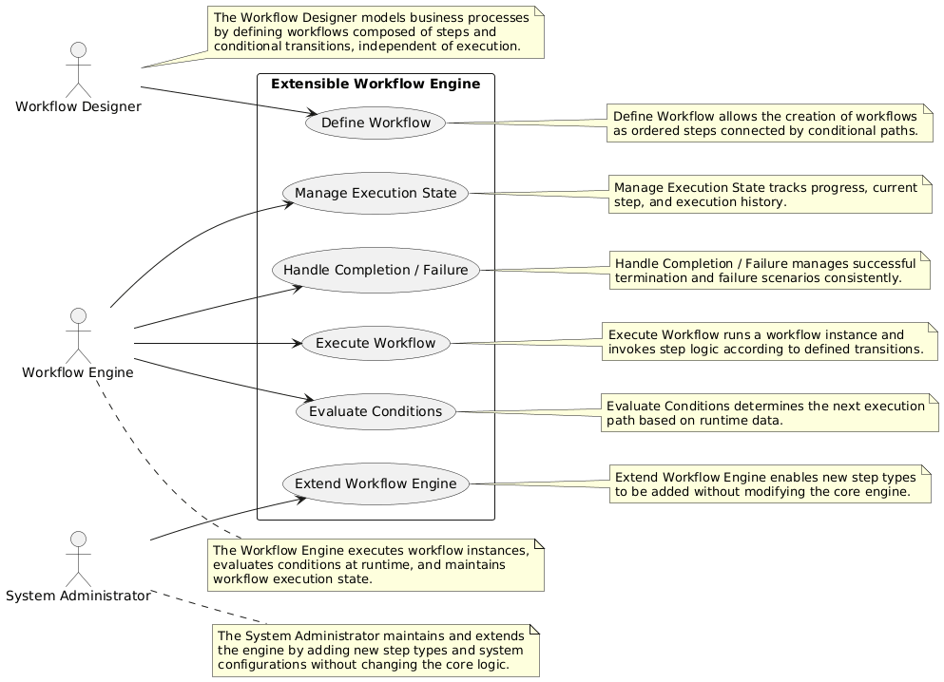
03 / Use Case Diagram
Use Case mode
Primary Actor
Workflow Designer – Models Business Processes by defining workflows composed of steps and conditional transitions, independent of executions
Secondary Actors
Workflow Engine – Executes workflow instances, executes conditions at runtime, and maintains workflow execution state.
Systems Administrator – maintains and extends the engine by adding new steps and system configurations without changing the core logic
Use Cases
Define Workflow, Execute Workflow, Evaluate Conditions Manage Execution State, Handle Completion / Failure Extend Workflow Engine

Slide 4
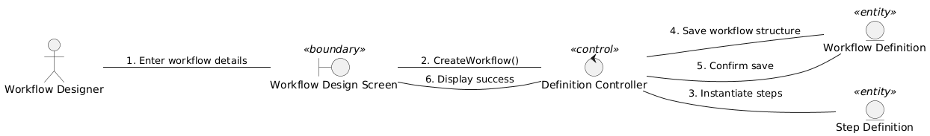
04 / Robustness Diagrams
Robustness Diagram : Define Workflow
This diagram focuses on the Workflow Designer interacting with the system to create a new process template.

Slide 5
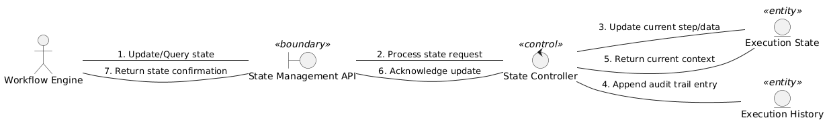
04 / Robustness Diagrams
2. Robustness diagram – Manage Execution State
State Controller - This control object acts as the logic layer that ensures the "current step" is never updated without first verifying the transition logic.
Execution State: This entity stores volatile data (like variables or the current index) during the run.
Execution History: This entity provides the "execution history" mentioned in your project description, allowing for auditing after the workflow finishes.

Slide 6
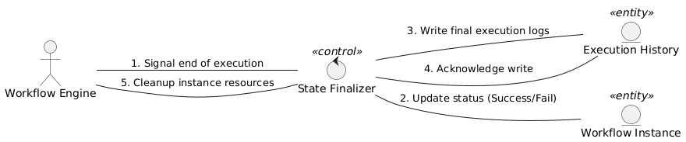
04 / Robustness Diagrams
3. Robustness Diagram : Handle Completion/ Failure
This ensures the system handles the end of a lifecycle consistently.

Slide 7
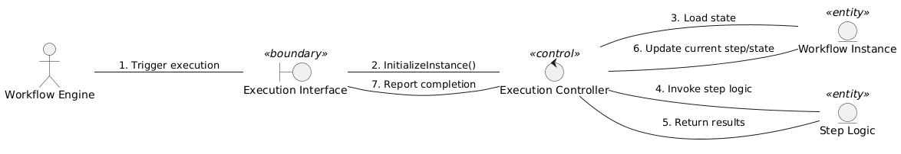
04 / Robustness Diagrams
4. Robustness Diagram : Execute Workflow
This represents the Workflow Engine (acting as a system actor) starting and running a workflow instance.

Slide 8
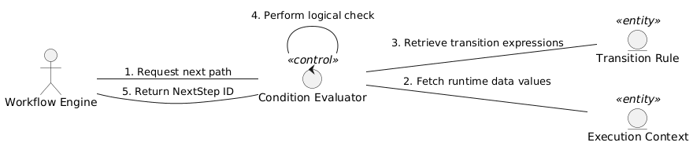
04 / Robustness Diagrams
5. Robustness Diagram - Evaluate Conditions
This is a logic-heavy use case where the engine determines the path between steps based on runtime data.

Slide 9
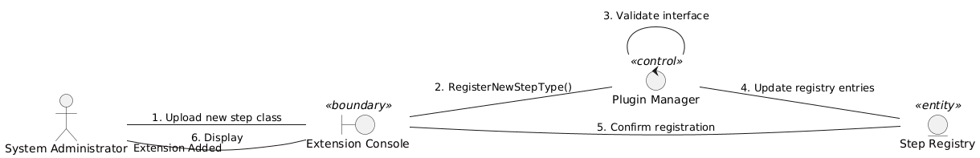
04 / Robustness Diagrams
6. Robustness Diagram - Extend Workflow Engine
This shows the System Administrator adding a new step type (a key requirement for your "Extensible" engine).

Slide 10
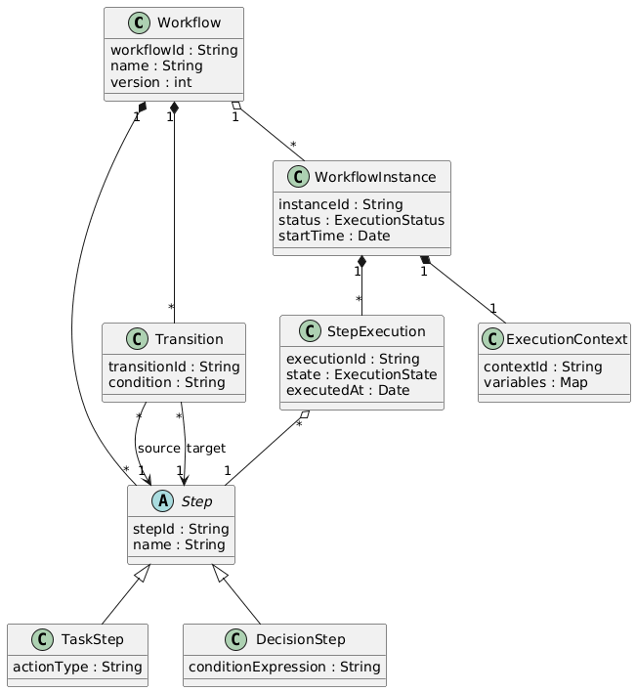
03 / Domain Class Diagram
Domain Class Model
Domain Class
The domain model represents an extensible workflow engine that separates workflow definition from runtime execution.
A Workflow defines a business process composed of multiple Steps and Transitions, with an initialStep marking the execution entry point.
Steps are abstract and specialized into TaskStep for executable actions and DecisionStep for conditional branching. Because steps and transitions define workflow structure, they are modeled using composition.
At runtime, a WorkflowInstance represents a single execution and owns its ExecutionContext and multiple StepExecution records. StepExecution tracks the state of individual steps while referencing the Step definition.
ExecutionStatus and ExecutionState enumerations standardize lifecycle tracking. The model captures workflow structure, execution behavior, and conditional flow while maintaining extensibility and adhering to object-oriented analysis principles.

